Slide 1
Digital Forensics Acquiring Digital Evidence
Dr. Tran The Son
Vietnam – Korea University

Slide 2
Contents
DF file formats
Raw format
Advanced forensic format
Acquiring volatile memory (live)
Virtual (Swap)
RAM
Acquiring nonvolatile memory
Hard disk
Physical/Logical Drive
Network Acquisition

Slide 3
Raw File Format
it is a bit-by-bit copy of the drive’s raw data and can be used to image the entire drive or a single volume (partition) within it.
Raw format is the default file format for the output generated by the famous Linux/UNIX dd command, and it is supported by most computer forensics software.
Extension: .001, .dd, .dmg, .raw, and .img
The main disadvantage of the Raw format is that it requires the same amount of storage space as the source drive because data in Raw format cannot be compressed

Slide 4
Advanced Forensic format
Advanced forensic format (AFF) is an open-source, extensible file format.
Compression algorithms Zlib and LZMA are both supported.
Support multiple files after created.
supports drive image encryption,
Allows to password-protect the acquired image
Ext: .afm or .afd (divided files)

Slide 5
Live memory (RAM) acquisition
Information that can be found in RAM includes the following:
Keys for encryption
Running procedures
Console commands that have been executed
Items in the clipboard
Data from a network
Contents of decrypted
Hives of the registrar
Image and text files
Deleted files
Web Browsing Logs
Registry keys that are open and active
Passwords for Web accounts (for example, e-mail, social media, and
cloud storage)
Instant messaging
Exploit information
Rootkit and Trojan malwares
Evidence of activity that is not usually saved on the local hard drive

Slide 6
Virtual memory: Swap space
Virtual memory is a file that compensates for RAM’s limited capacity
Windows
Linux
C:\pagefile.sys
Swap file
Virtual memory acquisition is a critical part of the forensic process because it
can contain valuable information such as user passwords, encryption keys,
Web browser activity, and other important artifacts that are transferred from
the RAM.

Slide 7
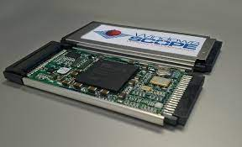
Challenges acquiring RAM
Locked Windows
use CaptureGUARD and Phantom Probe hardware
use a direct memory access (DMA) attack to get the password out of RAM
It is worth noting that the captured image is larger than the RAM (in this case, we are capturing a PC with 8 GB of RAM; the image size is approximately 8.269 GB). so make sure it is big enough to hold the file you will be making.

Slide 8
Hard disk acquisition
Consider
The size of the (suspicious) source drive
Time frame in which the acquisition will be completed
Is it possible to bring the questionable digital media (for example, a hard drive) to the lab with you?
Is it possible to shut down the target machine to obtain its drive data?

Slide 9
Hard disk acquisition
Acquiring physical resources
a bit-by-bit/sector-by-sector clone of a hard disc (also known as a bit-stream image)
Any computer forensics program can read bit-stream images
Bit-stream disk-to-image file conversion (most frequently used)
Bit-stream disk-to-disk
Logical acquisition
just capturing a subset of active data
Sparse acquisition
captures only specific files that are related to the investigated case.
deleted data and fragments thereof are also captured

Slide 10
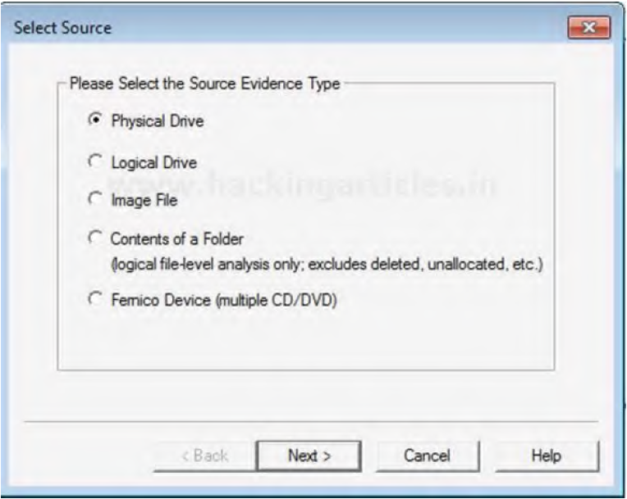
Capturing hard drives using FTK imager
Physical drive: enable you to capture all data on a hard drive (bit by bit), even unallocated space and deleted files.
Logical disk: Capture only a certain partition within a drive, such as the D: drive.
Image file: Choose an image file to use as a source here.
Folder contents: Assign a source to a folder.
Fernico device: Recover forensics pictures from a variety of sources (including multiple CDs/DVDs).

Slide 11
Network acquisition
Network forensics and cloud forensics face similar issues; for example, e-crime, which involves the use of networked computers, is on the rise.
Working on criminal cases involving the usage of computer networks as a forensic examiner, you can anticipate confronting the following challenges.

